Slide 1

Memory management
Er. Deeyoranjan Dongol

Slide 2
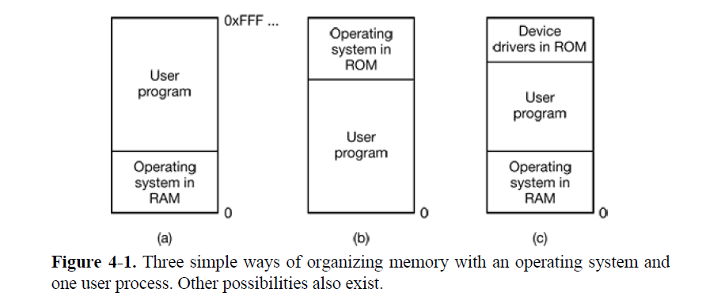
MEMORY MANAGEMENT
Act of providing ways to allocate portions of memory to programs at their request, and freeing it for reuse when no longer needed
Uniprogramming
Notes:
The simplest possible memory management scheme is to run just one program at a
time, sharing the memory between that program and the operating system.
The operating system may be at the bottom of memory in RAM (Random Access Memory), as shown in Fig. 4-1(a), or it
may be in ROM (Read-Only Memory) at the top of memory, as shown in Fig. 4-1(b),
or the device drivers may be at the top of memory in a ROM and the rest of the system
in RAM down below, as shown in Fig. 4-1(c).

Slide 3
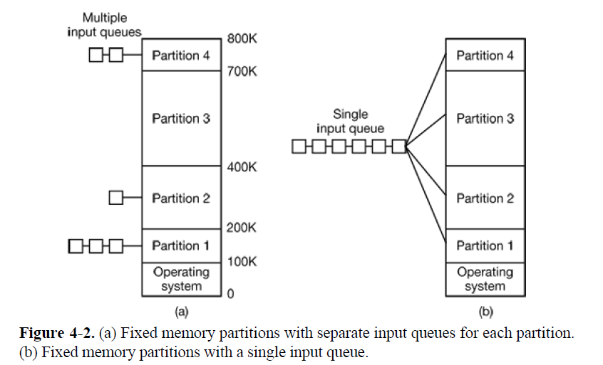
MEMORY MANAGEMENT
Multiprogramming with Fixed Partition
Notes:
When the queue for a large partition is empty but the queue for a small partition is full, as is the case
for partitions 1 and 3. Here small jobs have to wait to get into memory, even though plenty of memory
is free
An alternative organization is to maintain a single queue as in Fig. 4-2(b). Whenever a partition
becomes free, the job closest to the front of the queue that fits in it could be loaded into the empty
partition and run

Slide 4
MEMORY MANAGEMENT
Relocation and Protection
Procedure call at absolute address 100
Program loaded in Partition 1(at address 100K)
Jump to absolute address 100 (inside OS)
Needed to call 100K+100
Solution
Base and Limit registers
Base registers loads start of its partition and limit
registers loads length of partition
Base registers contains 100K, a CALL 100 instruction
is turned into CALL 100K+100 instruction
Notes:
suppose that the first instruction is a call to a procedure at absolute address 100 within the binary file produced by the linker. If this program is loaded in partition 1 (at address 100K), that instruction will jump to absolute address 100, which is inside the operating system. What is needed is a call to 100K + 100. If the program is loaded into partition 2, it must be carried out as a call to 200K + 100, and so on.
This problem is known as the relocation problem.
An alternative solution to both the relocation and protection problems is to equip the machine with two special hardware registers, called the base and limit registers. When a process is scheduled, the base register is loaded with the address of the start of its partition, and the limit register is loaded with the length of the partition. Every memory address generated automatically has the base register contents added to it before being sent to memory. Thus if the base register contains the value 100K, a CALL 100 instruction is effectively turned into a CALL 100K+100 instruction, without the instruction itself being modified. Addresses are also checked against the limit register to make sure that they do not attempt to address memory outside the current partition. The hardware protects the base and limit registers to prevent user programs from modifying them.

Slide 5
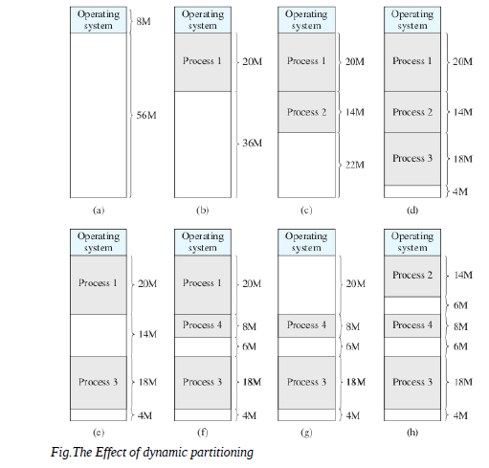
MEMORY MANAGEMENT
Multiprogramming with Variable Partition
Notes:
When a process is brought into main memory, it is allocated exactly as much memory as it requires and no more.

Slide 6
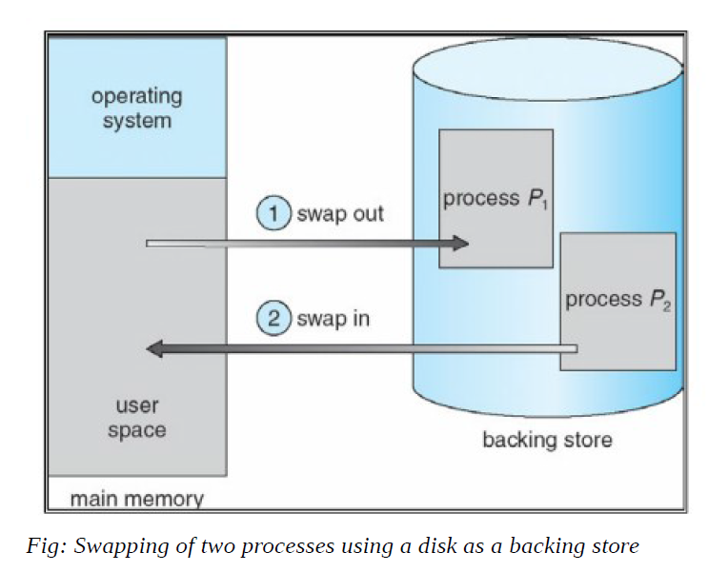
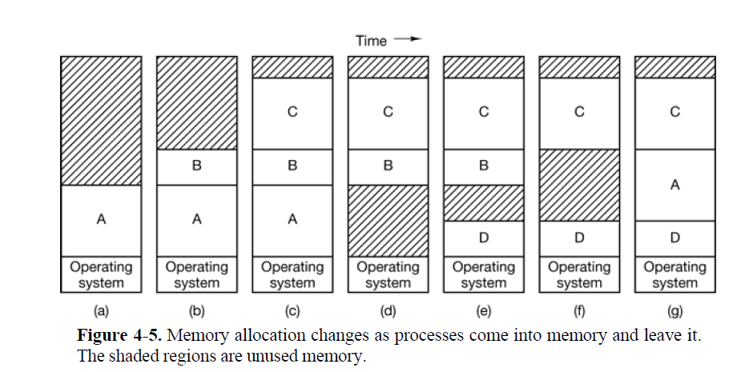
SWAPPING
Notes:
Initially only process A is in memory. Then processes B and C are created or swapped in from disk.
In Fig. 4- 5(d) A is swapped out to disk.
Then D comes in and B goes out.
Finally A comes in again. Since A is now at a different location, addresses contained in it must be relocated, either by software when it is swapped in or (more likely) by hardware during program execution.

Slide 7
SWAPPING
Swapping
Consists of bringing in each process in its entirety, running it for a while, then putting it back on the disk
Compaction
When swapping creates multiple holes in memory, it is possible to combine them all into one big one by moving all the processes downward as far as possible
Coalescing
Process of merging two adjacent holes to form a single larger hole

Slide 8
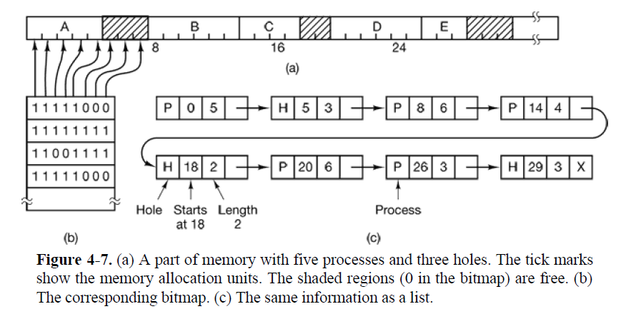
Memory Management with Bitmaps
Problem
When it has been decided to bring a k unit process into memory, the memory manager must search the bitmap to find a run of k consecutive 0 bits in the map. [Slow Operation]
Notes:
Another way of keeping track of memory is to maintain a linked list of allocated and
free memory segments, where a segment is either a process or a hole between two
processes. The memory of Fig. 4-7(a) is represented in Fig. 4-7(c) as a linked list of
segments. Each entry in the list specifies a hole (H) or process (P), the address at
which it starts, the length, and a pointer to the next entry.
Since the process table slot for the terminating process will normally point to the list entry for the process itself, it may be more convenient to have the list as a double-linked list

Slide 9
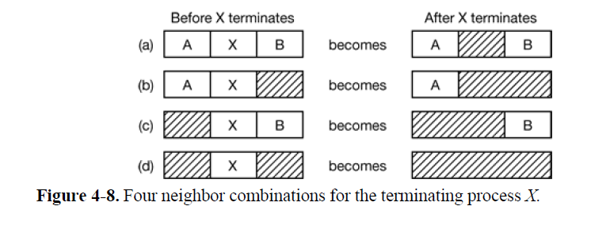
Memory Management with Linked Lists
Sorted by address
Advantage -updating the list is straightforward when a process terminates or swapped out
A terminating process normally has two neighbors - processes or holes

Slide 10
ALGORITHM TO ALLOCATE MEMORY TO NEWLY CREATED PROCESS
First Fit:
The process manager scans along the list of segments until it finds a hole that is big enough
The hole is then broken up into two pieces, one for the process and one for the unused memory, except in the statistically unlikely case of an exact fit
Next Fit:
It works the same way as first fit, except that it keeps track of where it is whenever it finds a suitable hole
The next time it is called to find a hole, it starts searching the list from the place where it left off last time, instead of always at the beginning, as first fit does
Notes:
When the processes and holes are kept on a list sorted by address, several algorithms can be used to allocate memory for a newly created process (or an existing process being swapped in from disk). We assume that the memory manager knows how much memory to allocate.

Slide 11
ALGORITHM TO ALLOCATE MEMORY TO NEWLY CREATED PROCESS
Best Fit:
It searches the entire list and takes the smallest hole that is adequate
It tries to find a hole that is close to the actual size needed
Worst Fit:
Always take the largest available hole so that the hole broken off will be big enough to be useful

Slide 12
EXAMPLE
Given five memory partitions of 100KB, 500KB, 200KB, 300KB and 600KB (in order). How would each of the first-fit, best-fit and worst-fit algorithms place processes of 212KB,417KB,112KB and 426KB(in order)? Which algorithm makes the most efficient use of memory?
First-fit:
212K is put in 500K partition
417K is put in 600K partition
112K is put in 288K partition (new partition 288K = 500K - 212K) 426K must wait
Best-fit:
212K is put in 300K partition
417K is put in 500K partition
112K is put in 200K partition
426K is put in 600K partition
Worst-fit:
212K is put in 600K partition
417K is put in 500K partition
112K is put in 388K partition
426K must wait

Slide 13
VIRTUAL MEMORY
Overlays
Programs did not fit in the available memory
Splitting the program into pieces called overlays
Overlay 0 runs first. When it is done, it would call another overlay
Virtual Memory
Basic idea
Memory required by a program may exceed the available physical memory
OS keeps parts of program currently in use in main memory and rest in disk
Notes:
a 16-MB program can run on a 4-MB machine by carefully choosing which 4 MB to keep in memory at each instant, with pieces of the program being swapped between disk and memory as needed

Slide 14
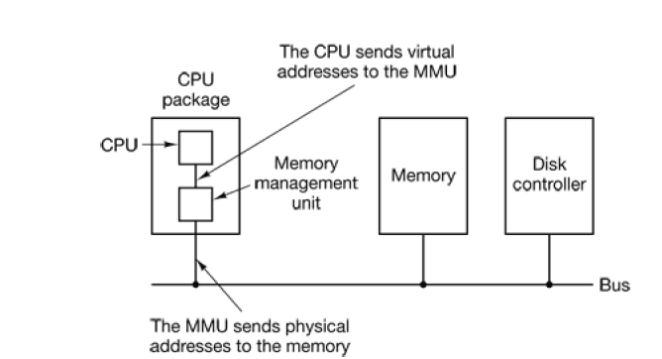
VIRTUAL MEMORY
Logical Vs Physical Address
Notes:
Program-generated addresses are called virtual addresses and form the virtual address space.
When virtual memory is used, the virtual addresses do not go directly to the memory bus.
Instead, they go to an MMU (Memory Management Unit) that maps the virtual addresses onto the physical memory
addresses

Slide 15
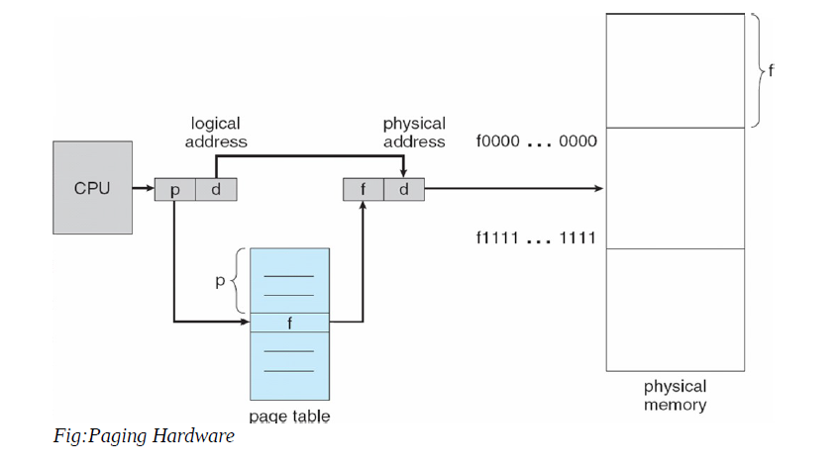
PAGING

Slide 16
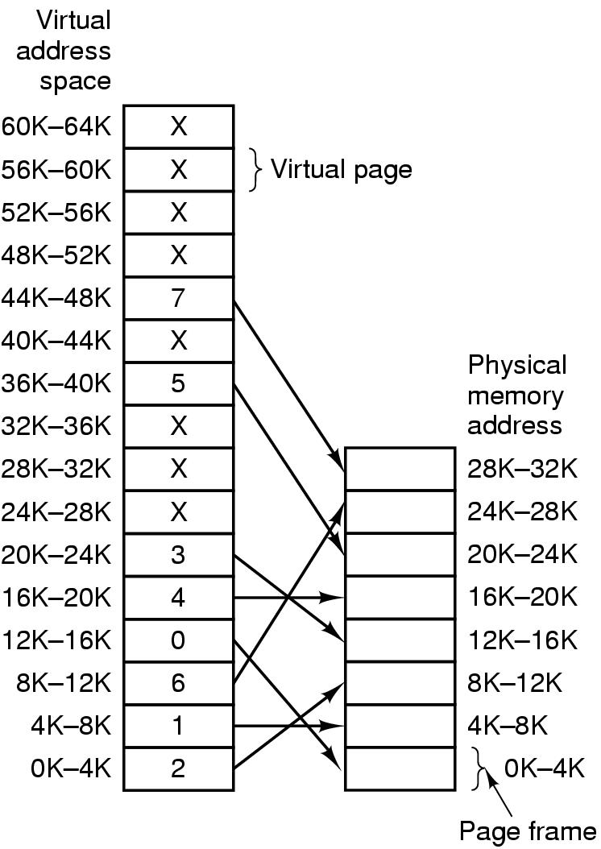
VIRTUAL MEMORY
A program has instruction
MOV REG,0
Page Table
Relation between virtual addresses and physical memory addresses given by page table. Every page begins on a multiple of 4096, ends 4095 addresses higher, so 4K–8K really means 4096–8191 and 8K to 12K means 8192–12287
16 bit addresses, 4 KB pages, 16 virtual pages and 8 page frames
Notes:
When the program tries to access address 0, for example, using the instruction
MOV REG,0 virtual address 0 is sent to the MMU. The MMU sees that this virtual address falls in
page 0 (0 to 4095), which according to its mapping is page frame 2 (8192 to 12287). It
thus transforms the address to 8192 and outputs address 8192 onto the bus. The
memory knows nothing at all about the MMU and just sees a request for reading or
writing address 8192, which it honors. Thus, the MMU has effectively mapped all
virtual addresses between 0 and 4095 onto physical addresses 8192 to 12287.
virtual address 20500 is 20 bytes from the start of virtual page 5 (virtual addresses 20480 to 24575)
and maps onto physical address 12288 + 20 = 12308.

Slide 17
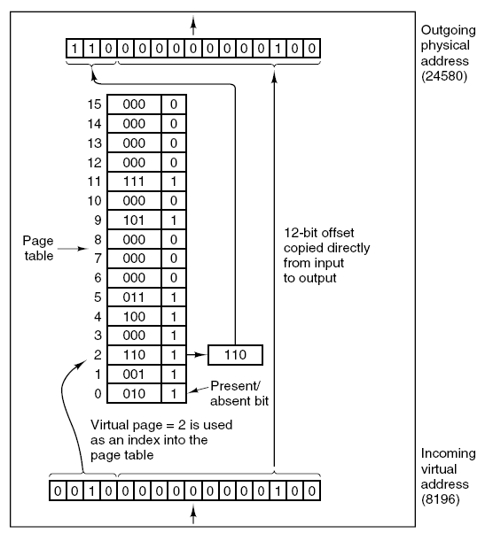
VIRTUAL MEMORY
Operation of MMU
Notes:
Virtual address 8196
4 bit = page number
12 bit = offset

Slide 18
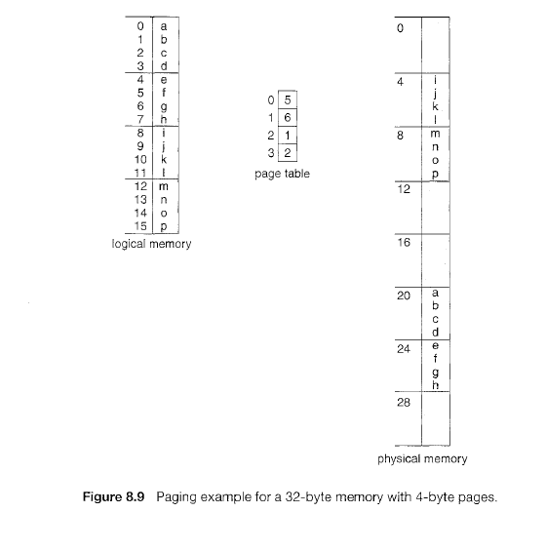
Notes:
Logical address 0 is in page 0 and offset 0 which is mapped to physical memory 20 [ 5x4 + 0 ]
Logical address 14 is in page 3 and offset 2 which is mapped to physical memory 10[2x4 + 2 ]

Slide 19
VIRTUAL MEMORY
Implementation Issues in Paging
The mapping from virtual address to physical address must be fast
1, 2 or sometimes more page table reference per instruction
If virtual address space is large page table will be large
32 bit addresses and 64 bits becoming common
With 4 KB page size, 32 bit address space 2²⁰ pages which requires 2²⁰ page table entries. Each process needs its own page table

Slide 20
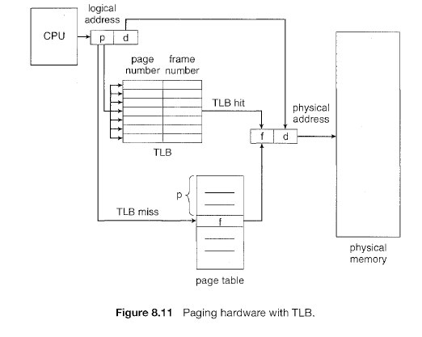
VIRTUAL MEMORY
TLBs (Translation Lookaside Buffers)
Notes:
If the page number is not in the TLB (known as a a memory reference to the page table must be made. When the frame number is obtained,
we can use it to access memory (Figure 8.11). In addition, we add the page number and frame number to the TLB, so that they will be found quickly on the
next reference. If the TLB is already full of entries, the operating system must select one for replacement. Replacement policies range from least recently
used (LRU) to random.

Slide 21
VIRTUAL MEMORY
TLBs (Translation Lookaside Buffers)
Small hardware device inside MMU for mapping virtual addresses to physical address.
Number of entries in TLB is normally not more than 64.
When MMU gets virtual address, first of all it looks TLB for physical address. If found, no memory reference is needed for page table access. Otherwise MMU does the ordinary page table lookup. It then evicts one of the TLB entry and replace it with the page that is just looked up.

Slide 22
VIRTUAL MEMORY
Multilevel Page Tables
Avoid keeping the page table in memory due to large size
Hierarchy of page tables
Entry 0 points to pages for program text
Entry 1 points to pages for data
Entry 1023 points to pages for stack
Only 4 page tables need to be kept into memory
For virtual address 4206596, how physical address is calculate?

Slide 23
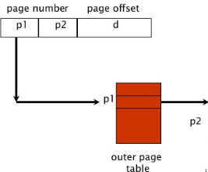
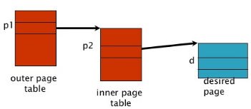
VIRTUAL MEMORY
Multilevel Page Tables

Slide 24
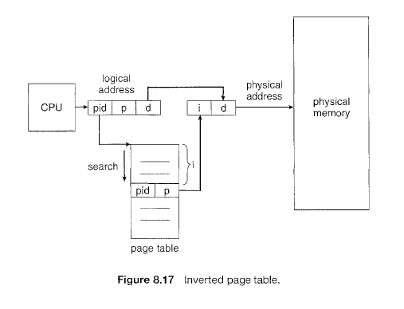
VIRTUAL MEMORY
Inverted Page Table
Notes:
An inverted page table has one entry for each real page (or frame) of memory.
Each entry consists of the virtual address of the page stored in that real memory location, with information about the process that owns the page.
Thus, only one page table is in the system, and it has only one entry for each page of physical memory.
Each inverted page-table entry is a pair <process-id, page-number> where the process-id assumes the role of the address-space identifier. When a memory reference occurs, part of the virtual address, consisting of <process-id, pagenumber>, is presented to the memory subsystem. The inverted page table is then searched for a match. If a match is found-say, at entry i-then the physical address <i, offset> is generated. If no match is found, then an illegal
address access has been attempted.

Slide 25
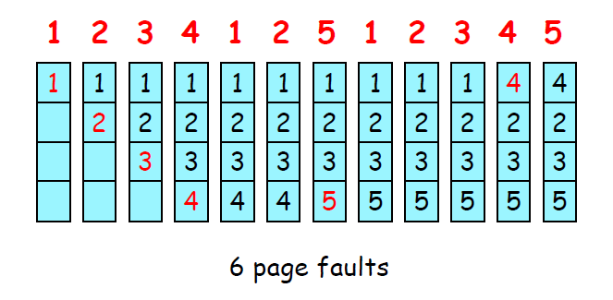
PAGE REPLACEMENT ALGORITHM
Optimal Page Replacement Algorithm
Replace the page that won’t be used for longest period in future
Difficult to implement and requires future knowledge of reference string
Useful mainly for comparison studies

Slide 26
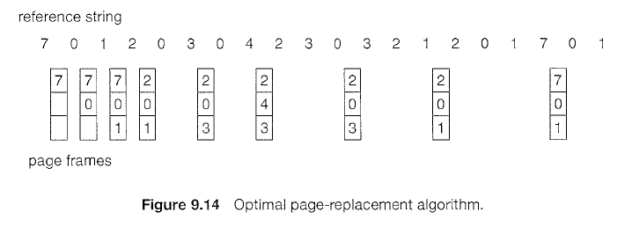
PAGE REPLACEMENT ALGORITHM

Slide 27
PAGE REPLACEMENT ALGORITHM
Not Recently Used (NRU)
Two status bits associated with each page
R is set when page is referenced
M is set when page is modified
When page fault occurs, divides all pages into four categories
Class 0: not referenced, not modified
Class 1: not referenced, modified
Class 2: referenced, not modified
Class 3: referenced, modified
Removes a page at random with lowest numbered nonempty class

Slide 28
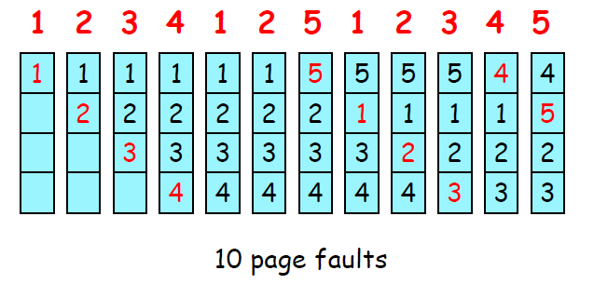
PAGE REPLACEMENT ALGORITHM
First-In-First-Out (FIFO)
Replace the oldest page or the page that arrived first
Easy to implement

Slide 29
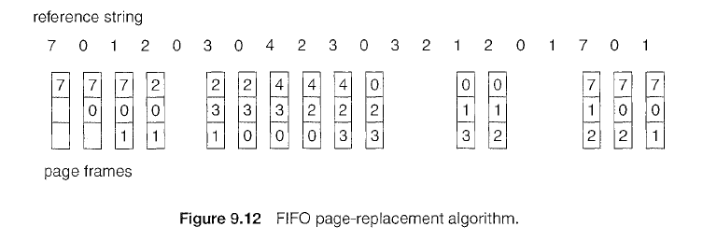
PAGE REPLACEMENT ALGORITHM

Slide 30
PAGE REPLACEMENT ALGORITHM
Least Frequently Used (LFU)
Replace the page that has the least frequency
If the frequency is same perform FIFO
7 | 0 | 1 | 2 | 0 | 3 | 0 | 4 | 2 | 3 | 0 | 3 | 2 | 1 | 2
7 | 7 | 7 | 2 | 2 | 2 | 2 | 4 | 4 | 3 | 3 | 3 | 3 | 3 | 3
 | 0 | 0 | 0 | 0 | 0 | 0 | 0 | 0 | 0 | 0 | 0 | 0 | 0 | 0
 |  | 1 | 1 | 1 | 3 | 3 | 3 | 2 | 2 | 2 | 2 | 2 | 1 | 2
10 Page Faults
Frequencies
7 = 0 0 = 4 1 = 0 2 = 1
3 = 2 4 = 0

Slide 31
PAGE REPLACEMENT ALGORITHM
Least Frequently Used (LFU)
Initial Frequencies
7 = 0 0 = 0 1 = 0 2 = 0 3 = 0 4 = 0
Reference String 7
7 = 1 0 = 0 1 = 0 2 = 0 3 = 0 4 = 0
Reference String 0
7 = 1 0 = 1 1 = 0 2 = 0 3 = 0 4 = 0
Reference String 1
7 = 1 0 = 1 1 = 1 2 = 0 3 = 0 4 = 0
Reference String 2 (Page Miss)
7 = 0 0 = 1 1 = 1 2 = 1 3 = 0 4 = 0
Reference String 0 (Page Hit)
7 = 0 0 = 2 1 = 1 2 = 1 3 = 0 4 = 0
Reference String 3 (Page Miss)
7 = 0 0 = 2 1 = 0 2 = 1 3 = 1 4 = 0
Reference String 0 (Page Hit)
7 = 0 0 = 3 1 = 0 2 = 1 3 = 1 4 = 0
7
7
0
7
0
1
2
0
1
2
0
1
2
0
3
2
0
3

Slide 32
PAGE REPLACEMENT ALGORITHM
Least Frequently Used (LFU)
Reference String 4 (Page Miss)
7 = 0 0 = 3 1 = 0 2 = 0 3 = 1 4 = 1
Reference String 2 (Page Miss)
7 = 0 0 = 3 1 = 0 2 = 1 3 = 0 4 = 1
Reference String 3 (Page Miss)
7 = 0 0 = 3 1 = 0 2 = 1 3 = 1 4 = 0
Reference String 0 (Page Hit)
7 = 0 0 = 4 1 = 0 2 = 1 3 = 1 4 = 0
Reference String 3 (Page Hit)
7 = 0 0 = 4 1 = 0 2 = 1 3 = 2 4 = 0
Reference String 2 (Page Hit)
7 = 0 0 = 4 1 = 0 2 = 2 3 = 2 4 = 0
Reference String 1 (Page Miss)
7 = 0 0 = 4 1 = 1 2 = 1 3 = 2 4 = 0
Reference String 2 (Page Hit)
7 = 0 0 = 4 1 = 0 2 = 1 3 = 2 4 = 0
4
0
3
4
0
2
3
0
2
3
0
2
3
0
2
3
0
2
3
0
1
3
0
2

Slide 33
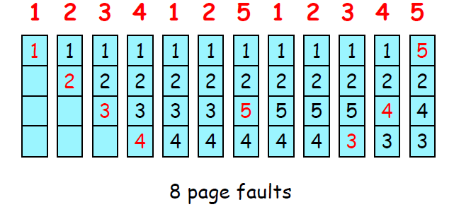
PAGE REPLACEMENT ALGORITHM
Least Recently Used (LRU)
Replace the page that hasn’t been used for longest time

Slide 34
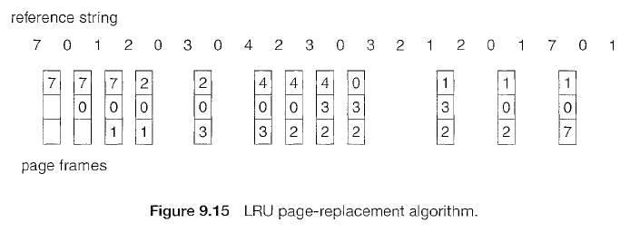
PAGE REPLACEMENT ALGORITHM

Slide 35
PAGE REPLACEMENT ALGORITHM
Second Chance Page Replacement
Modification to FIFO that avoids the problem of throwing heavily used page
Inspects R bit
If R=0, page is old and unused so replaced
If R=1, it is set to 0 and put at the end of the list and its load time is updated and search continues

Slide 36
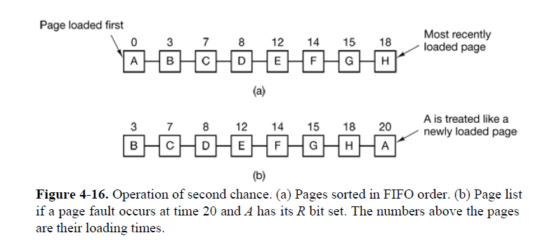
PAGE REPLACEMENT ALGORITHM
Second Chance Page Replacement

Slide 37
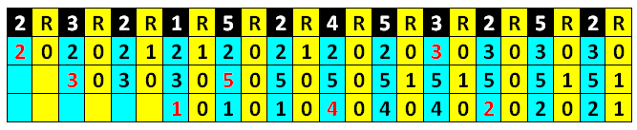
PAGE REPLACEMENT ALGORITHM
Second Chance Page Replacement
Reference String: 2 3 2 1 5 2 4 5 3 2 5 2
7 Page Faults

Slide 38
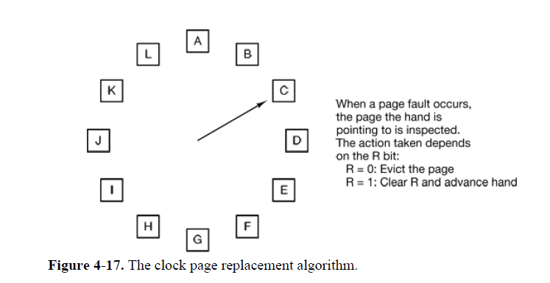
PAGE REPLACEMENT ALGORITHM
Clock Page Replacement
Not surprisingly, this algorithm is called clock. It differs from second chance only in the implementation.
Notes:
Keeps all page frame in a circular lists
When a page fault occurs, the page being pointed to by the hand is inspected.
If its R bit is 0, the page is evicted, the new page is inserted into the clock in its place, and the hand is advanced one position.
If R is 1, it is cleared and the hand is advanced to the next page. This process is repeated until a page is found with R = 0.

Slide 39
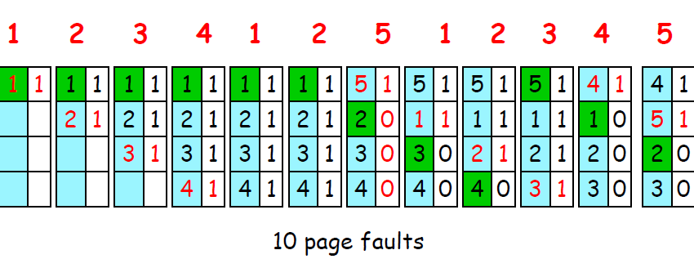
PAGE REPLACEMENT ALGORITHM

Slide 40
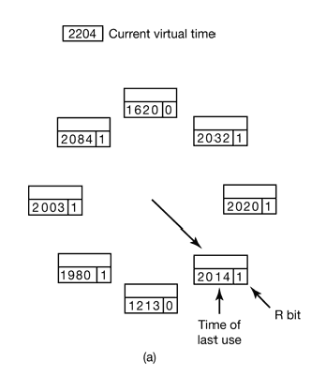
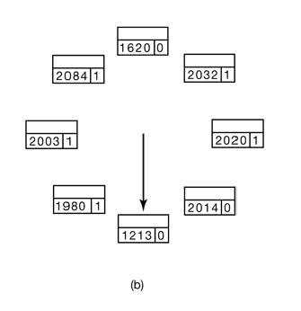
PAGE REPLACEMENT ALGORITHM
WS (Working Set) Clock Page Replacement

Slide 41
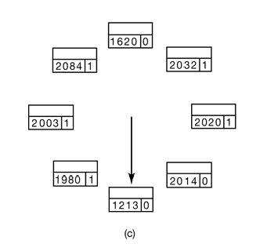
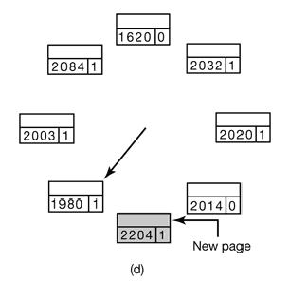
PAGE REPLACEMENT ALGORITHM
WS (Working Set) Clock Page Replacement
Notes:
The data structure needed is a circular list of page frames, as in the clock algorithm,
and as shown in Fig. 4-22(a). Initially, this list is empty. When the first page is loaded,
it is added to the list. As more pages are added, they go into the list to form a ring.
Each entry contains the Time of last use field from the basic working set algorithm, as
well as the R bit (shown) and the M bit (not shown).
As with the clock algorithm, at each page fault the page pointed to by the hand is
examined first. If the R bit is set to 1, the page has been used during the current tick so
it is not an ideal candidate to remove. The R bit is then set to 0, the hand advanced to
the next page, and the algorithm repeated for that page. The state after this sequence
of events is shown in Fig. 4-22(b).
Now consider what happens if the page pointed to has R = 0, as shown in Fig. 4-22(c).
If the age is greater than t and the page is clean, it is not in the working set and a valid
copy exists on the disk. The page frame is simply claimed and the new page put there,
as shown in Fig. 4-22(d). On the other hand, if the page is dirty, it cannot be claimed
immediately since no valid copy is present on disk. To avoid a process switch, the
write to disk is scheduled, but the hand is advanced and the algorithm continues with
the next page. After all, there might be an old, clean page further down the line that
can be used immediately.

Slide 42
Locality of Reference
During any phase of execution, the process references only a relatively small fraction of its pages
Working Set
The set of pages that a process is currently using
Thrashing
A program causing page faults every few instructions
Prepaging
Loading the pages before letting processes run
Notes:
If the entire working set is in memory, the process will run
without causing many faults until it moves into another execution phase (e.g., the next
pass of the compiler). If the available memory is too small to hold the entire working
set, the process will cause many page faults and run slowly since executing an
instruction takes a few nanoseconds and reading in a page from the disk typically
takes 10 milliseconds. At a rate of one or two instructions per 10 milliseconds, it will
take ages to finish. A program causing page faults every few instructions is said to be
thrashing

Slide 43

PAGE REPLACEMENT ALGORITHM
Belady’s Anomaly
The page referenced string is as
Implementing FIFO
Page frame = 3 , Page fault = 9
Page frame = 4, Page fault = 10

Slide 44
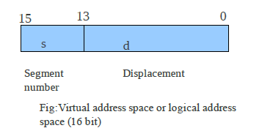
SEGMENTATION
Segmentation
Supports user view of memory
Logical in nature and variable in size
Divide logical address into different segments
Consists of segment number and Length

Slide 45
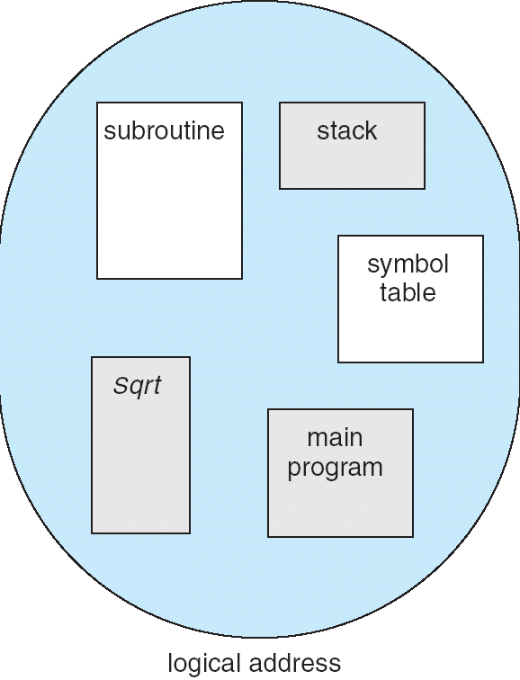
SEGMENTATION
User’s View of Memory

Slide 46
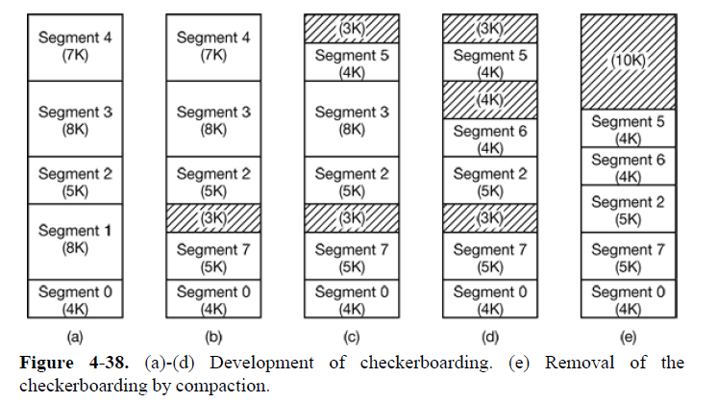
SEGMENTATION
Implementation of Segmentation

Slide 47
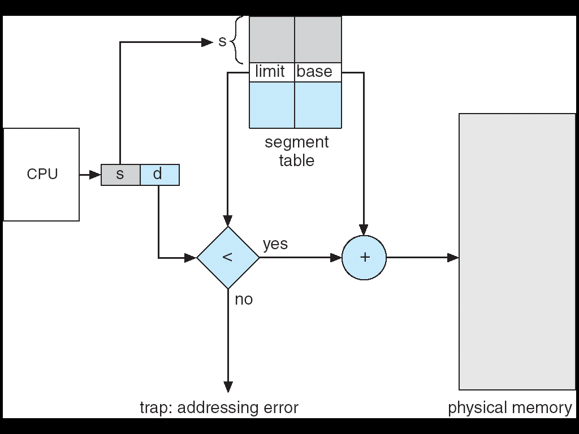
SEGMENTATION
Address Translation Architecture
Notes:
Each entry in the segment table has a segment base and a segment limit. The segment base contains the starting physical address where the segment resides in memory, and the segment limit specifies the length of the segment.
A logical address consists of two parts: a segment number, s, and an offset into that segment, d.
The segment number is used as an index to the segment table. The offset d of
the logical address must be between 0 and the segment limit. If it is not, we trap
to the operating system (logical addressing attempt beyond end of segment). When an offset is legal, it is added to the segment base to produce the address in physical memory of the desired byte. The segment table is thus essentially an array of base-limit register pairs.

Slide 48
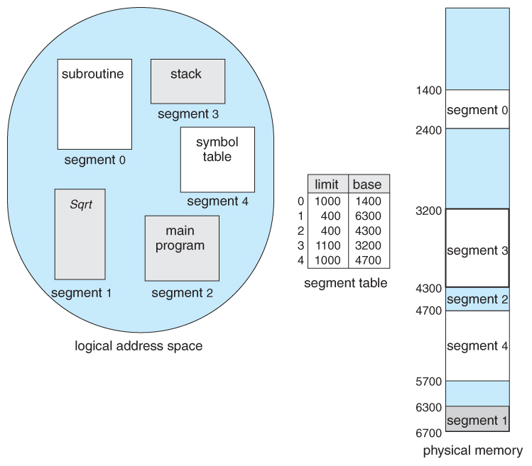
SEGMENTATION
Segmentation Example
Notes:
As an example, consider the situation shown in Figure 8.20. We have five segments numbered from 0 through 4. The segments are stored in physical
memory as shown. The segment table has a separate entry for each segment, giving the beginning address of the segment in physical memory (or base) and the length of that segment (or limit). For example, segment 2 is 400 bytes long and begins at location 4300. Thus, a reference to byte 53 of segment 2 is mapped onto location 4300 +53= 4353. A reference to segment 3, byte 852, is mapped to 3200 (the base of segment 3) + 852 = 4052. A reference to byte 1222 of segment 0 would result in a trap to the operating system, as this segment is only 1000 bytes long.

Slide 49
Consider the following segment table
Segment | Base | Length
0 | 219 | 600
1 | 2300 | 14
2 | 90 | 100
3 | 1327 | 580
4 | 1952 | 96
What are the physical addresses for the following logical address
0, 430
1,10
3,400
4,112
Notes:
0, 430 => 219+430 = 649
1, 10 => 2300+10 = 2310
2,500 => illegal reference, trap to Operating System
3, 400 => 1327+400 = 1727
4, 112 => illegal reference, trap to Operating System

Slide 50
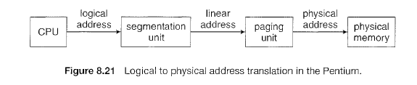
SEGMENTATION
Segmentation with Paging : INTEL PENTIUM

Slide 51

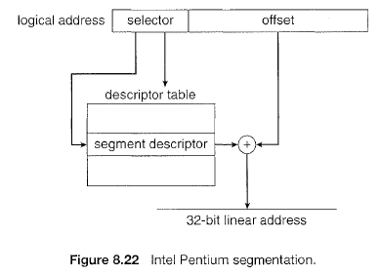
SEGMENTATION
Segmentation with Paging : INTEL PENTIUM
Notes:
Logical address divided into two partitions- first partition(LDT) and second partition (GDT)
Each entry in LDT & GDT consists of segment descriptor ( base and limit)
Segment register points to appropriate entry in LDT or GDT
Two level paging scheme
Page 333

Slide 52

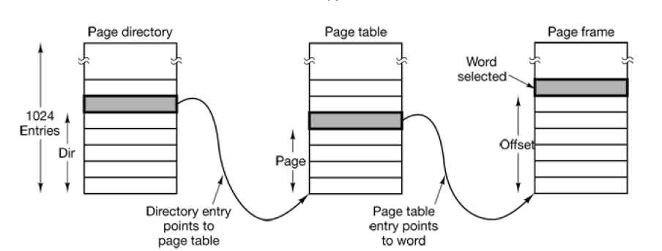
SEGMENTATION
Segmentation with Paging : INTEL PENTIUM

Slide 53
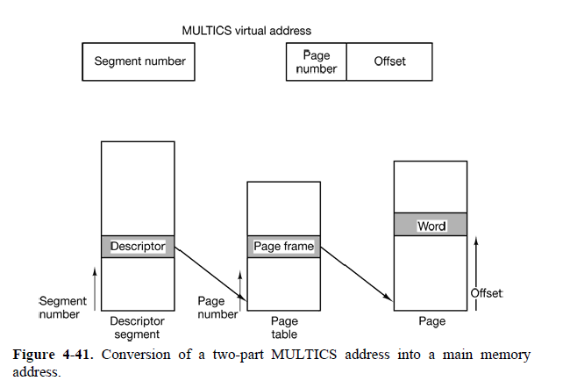
SEGMENTATION
Segmentation with Paging : MULTICS

Slide 54
When a memory reference occurred, the following algorithm was carried out
The segment number was used to find the segment descriptor
A check was made to see if the segment page table was in memory. If it was, it was located. If it was not, a segment fault occurred. If there was a protection violation, a trap occurred.
The page table entry for the requested virtual page was examined. If the page itself was not in memory, a page fault was triggered. If it was in memory, the main memory address of the start of the page was extracted from the page table entry
The offset was added to the page origin to give the main memory address where the word was located
The read or store finally took place

Slide 55
BUDDY SYSTEM
Entire memory space available for allocation is initially treated as a single block whose size is a power of 2
When the first request is made, if its size is greater than half of the initial block then the entire block is allocated. Otherwise, the block is split in two equal companion buddies
If the size of the request is greater than half of one of the buddies, then allocate one to it. Otherwise, one of the buddies is split in half again
This method continues until the smallest block greater than or equal to the size of the request is found and allocated to it
When a process terminates the buddy block that was allocated to it is freed. Whenever possible, an unallocated buddy is merged with a companion buddy in order to form a larger free block
Two blocks are said to be companion buddies if they resulted from the split of the same direct parent block

Slide 56
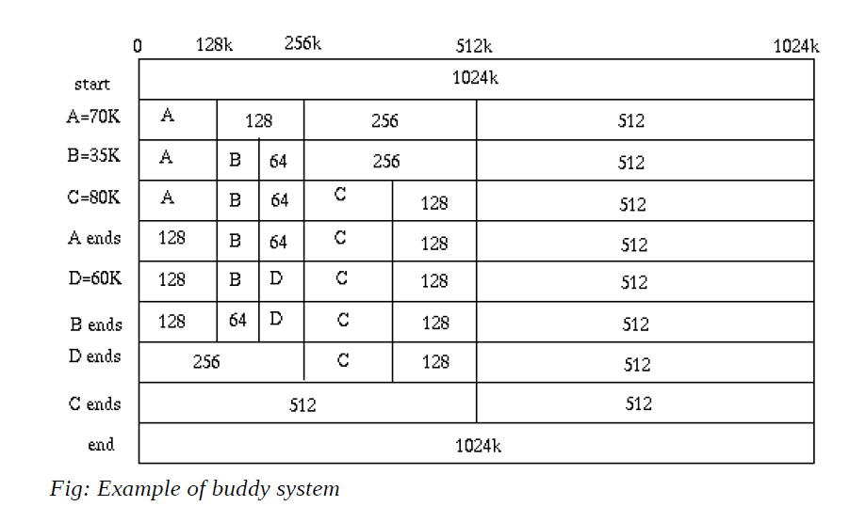
BUDDY SYSTEM
Notes:
In a buddy system, memory blocks are available of size 2K words, L≤K≤ U, where
2^{L} = smallest size block that is allocated
2^{U}=largest size block that is allocated; generally 2^{U} is the size of the entire memory available for
allocation

